Slide 1
School mapping in ESRI imagery
Andrija Gorup, Dominik Jambrović, Marin Kačan, Siniša Šegvić
October 24th, 2024

Slide 2
Recap from last meeting

Slide 3
2-stage training, fine-tune and eval on Anditi schools
2-fold cross-validation
50:50 train/val split of school locations
Add equal number of non-school locations
Sampled randomly throughout Vietnam
Unusually high results – F1: 93.91%
In spite of potentially problematic outdated imagery

Slide 4
Potential problems
Outdated imagery
Schools visible on Google Maps,
but not in ESRI images
Possible solutions:
Urban growth layer
ESRI metadata layer
Combination of the 2 methods
Compressed file size

Slide 5
Potential problems
Distinct appearance
Images from different regions have large variations in appearance

Slide 6
Potential problems
Many schools next to each other
For cross-validation experiments, we do a random 50:50 train/val split
Data leakage – overlapping images get into both splits
Schools in areas with distinct appearance
Similarity due to source of imagery
Tiles with very similar appearance get into both splits

Slide 7
Solution – split by clusters
More realistic results
F1: 81.55%
P: 95.94%
R: 73.97%

Slide 8
New contributions

Slide 9
Non-school sampling
Previously:
Non-schools sampled throughout Vietnam
Non-schools have no connection to the splits’ schools
Distance-based non-school sampling
Sample non-schools based on distance from schools

Slide 10
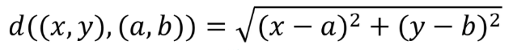
Distance-based non-school sampling
Schools are split into two clusters
For each cluster, calculate the corresponding centroid
For each non-school (OSM Vietnam data), calculate the Euclidean distance from both centroids
Normalize the distances to interval [0, 1]

Slide 11

Distance-based non-school sampling
Convert distances to probabilities of sampling
Sample non-schools for each cluster individually (no repetition)
$p_{c}$ $(x)=\frac{1}{d_{c,x}+ε}$

Slide 12
Results comparison
Random non-school sampling:
F1: 81.55%
P: 95.94%
R: 73.97%
Distance-based non-school sampling
F1: 86.07%
P: 97.71%
R: 77.71%

Slide 13
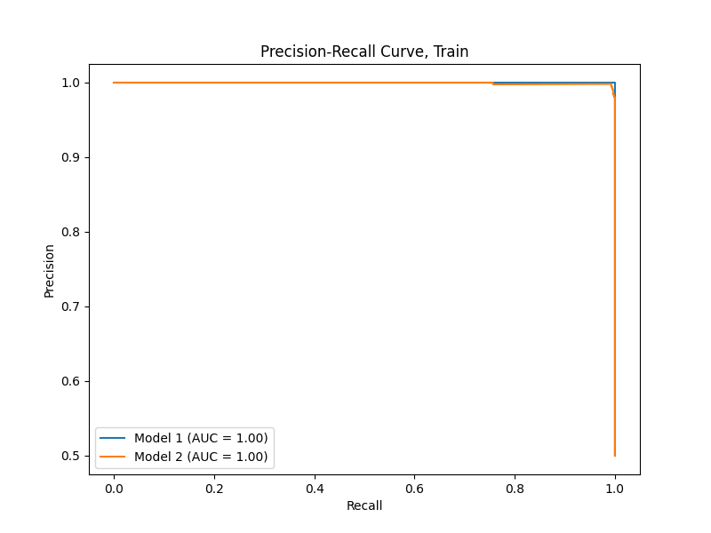
Precision-Recall Curve

Slide 14
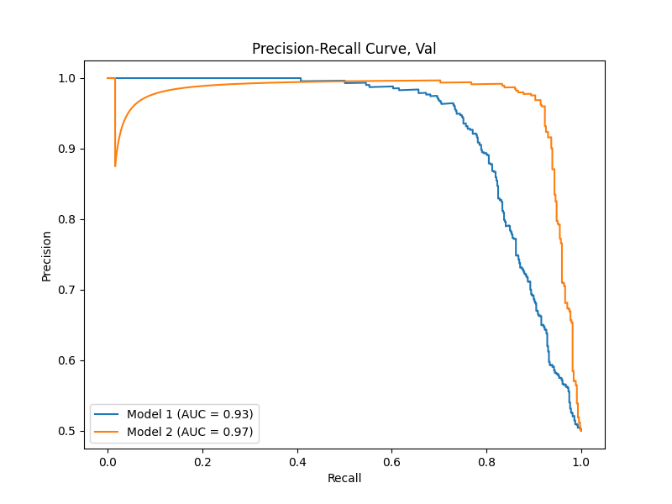
Precision-Recall Curve

Slide 15
Future work
Grayscale images experiment (try to eliminate appearance differences)
Dense inference (run newly fine-tuned model on tiles covering the chosen 26 districts)

